Slide 1
CHICAGO CRIME DATA ANALYSIS
By - Divyanshu Jaimini
03-03-2024

Slide 2

Introduction
A year ago in Chicago, the high incidence of crime prompted the government to take decisive action by launching an operation with top-performing police officers. As a year has passed since this decision, the government seeks to evaluate the reduction in crime cases and the advantages gained from this new operation. The government has engaged a freelancer data analyst to analyze the changes and improvements in crime rates.

Slide 3
Background: Chicago Overview
1. Population:
Chicago is the third-most populous city in the United States, with a diverse population of over 2.7 million people.
It is a major cultural, economic, and transportation hub located in the state of Illinois.
2. Geographical Area:
Situated in the northeastern part of Illinois, Chicago is nestled along the southwestern shore of Lake Michigan.
The city covers an area of approximately 234 square miles (606 square kilometers) and is characterized by its iconic skyline, expansive waterfront, and numerous neighborhoods.

Slide 4
Background: Chicago Overview
3. Historical Context Related to Crime:
Chicago has a complex history related to crime, particularly dating back to the early 20th century.
During the Prohibition era, Chicago gained notoriety as the base of operations for organized crime syndicates, including the infamous Al Capone and his gang.
The city has faced challenges related to gang violence, drug trafficking, and other criminal activities, particularly in certain neighborhoods with high levels of poverty and social deprivation.
Chicago has implemented diverse strategies like community policing, interventions, and partnerships to combat crime.
Chicago's crime persists, prompting efforts to improve policing, engage communities, and address underlying social issues.

Slide 5

Project Journey
PHASE 1
PHASE 2
PHASE 3
PHASE 4
Understanding the problem statement and data description of the given dataset
Cleaned the raw data by removing the unwanted columns and adding few new ones
Start analyzing the data in Power BI and Power Query Editor using it’s functionalities DAX, visualization etc.
Create a dashboard in Power BI and then answer the objective and subjective questions

Slide 6
PHASE 1
We will understand our problem statement and data description and will formulate the further strategy to approach the problem. Data description includes the description of each column in dataset and it’s significance.

Slide 7
Problem Statement
The government is seeking the following objectives from analysis:
If the case-solving time improved
What are the localities where the crime rate was higher
What can be the measures that can be taken to improve the crimes further

Slide 8
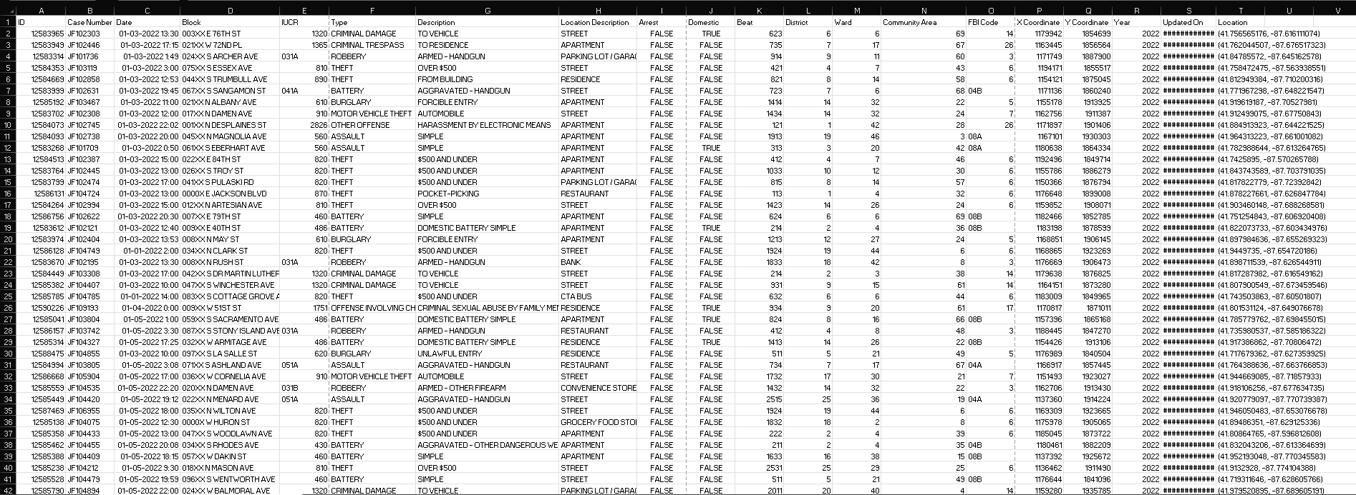
RAW DATA

Slide 9
Data Description
ID: A unique numerical identifier for each incident record.
Case Number: A unique alphanumeric identifier assigned to the incident.
Date: The date and time when the incident occurred.
Block: The block address where the incident took place, with street numbers partially obfuscated.
IUCR: The Illinois Uniform Crime Reporting code that corresponds to the nature of the incident.
Type: The general category of the crime reported.
Description: A more detailed description of the nature of the crime.
Location Description: The type of location where the incident occurred.
Arrest: Indicates whether an arrest was made (TRUE or FALSE).
Domestic: Indicates whether the incident was domestic-related (TRUE or FALSE).
Beat: Represents the patrol area's code where the incident was reported.

Slide 10
Data Description
District: The police district where the incident occurred.
Ward: The city ward where the incident occurred.
Community Area: The community area number where the incident occurred.
FBI Code: The code used by the FBI to categorize crimes.
X Coordinate: The X coordinate location data for mapping the incident.
Y Coordinate: The Y coordinate location data for mapping the incident.
Year: The year when the incident was reported.
Updated On: The date and time when the case was last acted upon, either due to an arrest being made or the case being closed for lack of evidence.
Latitude: The latitude where the incident occurred.
Longitude: The longitude where the incident occurred.
Location: The specific latitude and longitude coordinates where the incident occurred.

Slide 11
PHASE 2
Now when we are done with understanding our problem statement and dataset, we will start cleaning our data. In this process we’ll remove any columns that are not necessary in achieving our goal and will also add some more calculated columns.

Slide 12
Data Cleaning
Data cleaning is a crucial step in the data analysis process. It involves identifying and correcting errors or inconsistencies in your data to ensure accurate and reliable analysis.
Data cleaning is performed on inconsistent data to obtain consistent and better result.
In this dataset I removed columns like X-Coordinate and Y-Coordinate which are not used for fulfilling my goal set.
I found null values in columns like wards, X Coordinate, Y Coordinate, Latitude, Longitude. I removed columns X Coordinate and Y Coordinate because according to me there were not needed in the analysis. I did not removed or changed null values in rest of the columns because it would affect the number of crimes reported which was not good for my analysis.

Slide 13
Data Cleaning
Firstly I separated the latitude and longitude from “Location” column using split feature in Power Query Editor and assigned them their own column namely “Latitude” and “Longitude” respectively.
I also added column “Hour” and “Month” where I extracted hour and month respectively from “Date” column using power query editor.
In addition to “Hour” and “Month” column I also added a calculated column “Phase of day” in which I categorized the phase of the day when crime happened (i.e. early morning, morning, afternoon, evening, night and late night) using “Hour” column and DAX function SWITCH().
I added “Solving time (in days)” by finding date difference between “Date” and “Updated On” using DAX function DATEDIFF().
I also added “Domestic Crimes in District 8” in which I flagged records where domestic crimes happened in district 8, I used DAX function IF() for that.

Slide 14
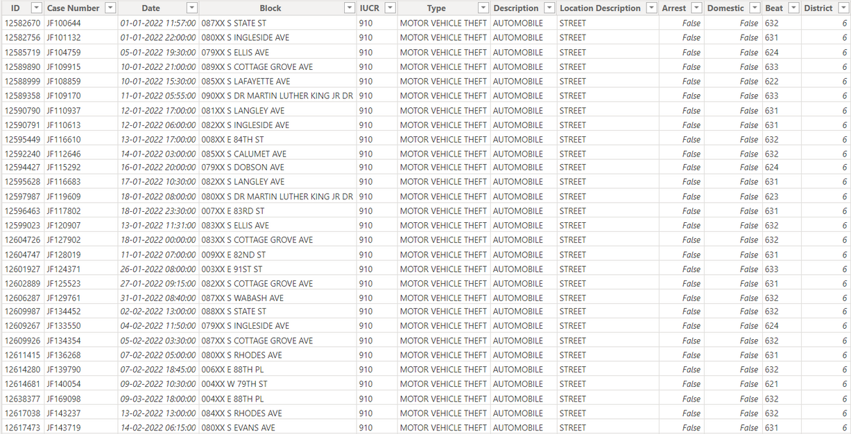
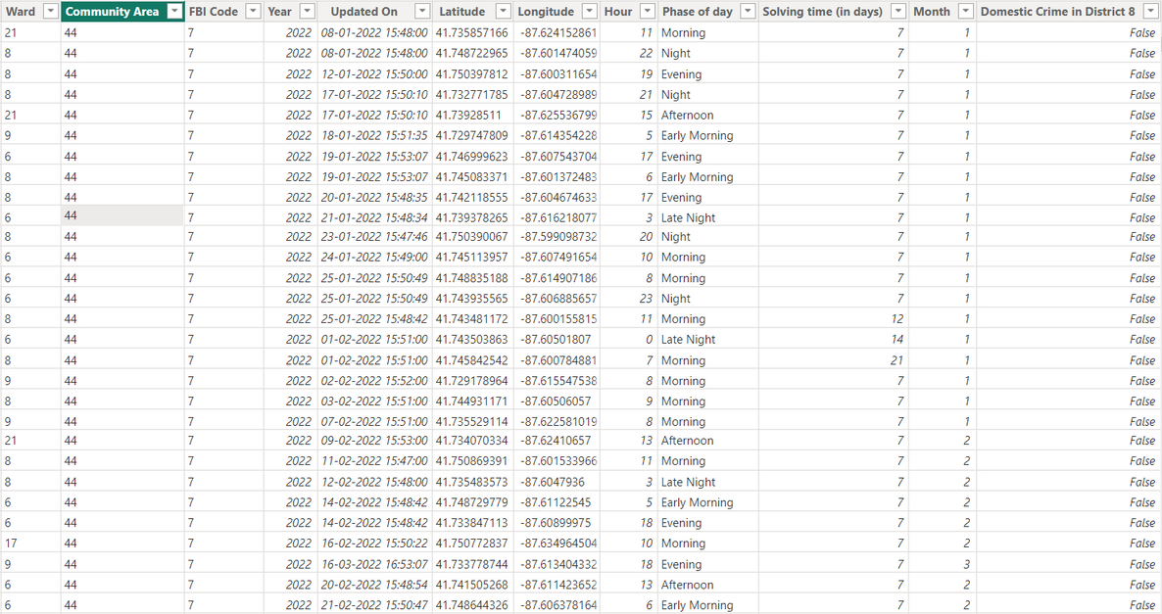
Data Cleaning
Image shown below is the data after cleaning it

Slide 15
PHASE 3
After cleaning our dataset we have our desired data on which we will perform our analysis using Power BI functionalities and DAX formulas, in this process we’ll get many important indicators which can help us in reaching our goal.

Slide 16
DAX Formulas:
DAX (Data Analysis Expressions) is a formula language used in Power BI for data modeling and analysis.
DAX formulas calculate values for calculated columns, measures, and calculated tables in the Power BI data model.
DAX offers a wide range of functions for data manipulation, aggregation, filtering, and calculations.
DAX formulas follow a syntax similar to Excel formulas, using functions, operators, and references to columns and tables.
DAX formulas evaluate data within different contexts, such as row context and filter context, to perform calculations dynamically.
Efficient DAX formulas are crucial for optimizing Power BI performance, especially in large datasets or complex models.

Slide 17
Power BI Visualizations:
Power BI offers various visualization types, including bar charts, line charts, pie charts, maps, tables, and more.
Visualizations in Power BI are interactive, allowing users to drill down, filter, and explore data dynamically.
Users can customize visualizations with formatting options, colors, titles, legends, and annotations to improve clarity and aesthetics.
Power BI visualizations seamlessly integrate with data models, allowing users to create insightful dashboards and reports.
Visualizations help users identify trends, patterns, and outliers in data, enabling data-driven decision-making and analysis.
Power BI visualizations can be shared with stakeholders through reports, dashboards, or embedded into websites or applications for broader consumption.

Slide 18
Data Analysis:
In this analysis I used some basic DAX functions like Average(), Divide(), Distinctcount().
I used Average() to find the average solving time (in days) and the formula was Average solving time (in days) = AVERAGE('crimes_data_2022 - crimes_data_'[Solving time (in days)])
I also used Divide() to find %Arrest made and ratio of domestic crimes to non-domestic crimes.
I used Distinctcount() for calculating no. of types of crimes, no. of districts, no. of beats, total crimes etc.
In addition to he basic DAX function I aslo used some complex ones like Calculate(), Filter(), Sumx(), Allexcept() etc. to calculate various measures like domestic crimes, no. of theft in district 8, total crimes by month, total arrested.

Slide 19
PHASE 4
So now we are done with our analysis, it’s time for using the findings to answer objective and subjective questions, and at last we’ll present our dashboard by which our stakeholders can interact with and gain more insights needed.

Slide 20
Objective Q&A
1. In analyzing the provided dataset with Power BI, ensure data cleaning to address inconsistencies and missing values before further analysis.
Ans 1. I found null values in columns like wards, X Coordinate, Y Coordinate, Latitude, Longitude. I removed columns X Coordinate and Y Coordinate because according to me there were not needed in the analysis. I did not removed or changed null values in rest of the columns because it would affect the number of crimes reported which was not good for my analysis.

Slide 21
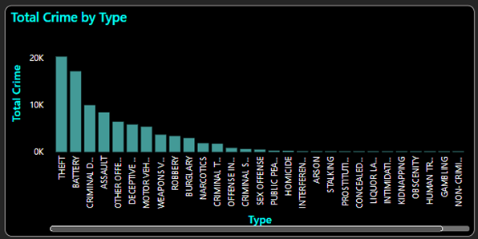
2. Crime Type Analysis: Assess the frequency of each crime type to identify the most prevalent crimes occurring in the area.
Ans 2. According to the data Theft, Battery and Criminal Damages are the most common types of crime.

Slide 22
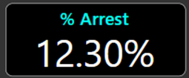

3. Arrest Rate Evaluation: Analyze the percentage of reported incidents that have resulted in an arrest to gauge law enforcement effectiveness.
Ans 3. I have created a new measure which gave me percentage of arrests for total number of crimes.

Slide 23
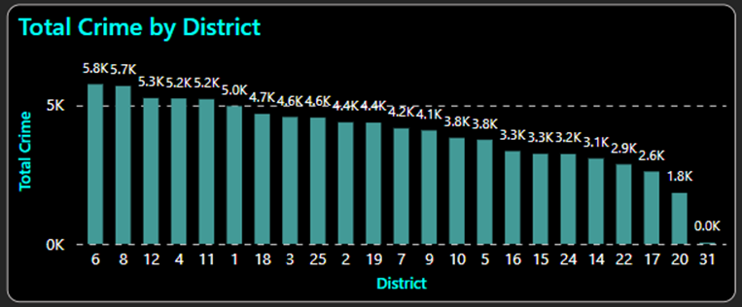
4. District Crime Distribution Assessment: Calculate the number of crimes in each district to understand how crime is distributed across the city and identify high-crime areas.
Ans 4. According to the bar graph created district 6,8,12,4 and 11 are the districts with most crimes.

Slide 24

5. How many categorical attributes are there in the data?
Ans 5. According to my analysis there are 5 categorical attributes in data provided
6. Were there any Null values in the data, if there were how did you handle them? What is the ideal way to handle Null values?
Ans 6. Yes, there were null values in the data in columns namely Ward, X Coordinate, Y Coordinate, Latitude, Longitude.
I did not removed records with null values in any of the column because it would remove those records from the data and would affect our analysis, I kept the those records same as they were.
Some ways to deal with null values is to replace them with the Mean or mode of that column (if applicable) or we can just remove those null values if their absence won’t affect our analysis.

Slide 25
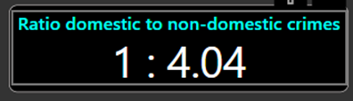
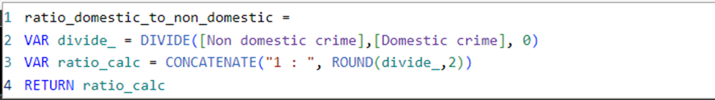
7. Domestic Crime Proportion Analysis: Analyze the ratio of domestic-related crimes to other types of crimes to understand the prevalence of domestic incidents.
Ans 7. I made a measure to get the ratio of domestic crimes to non-domestic crimes and represented it as a card

Slide 26
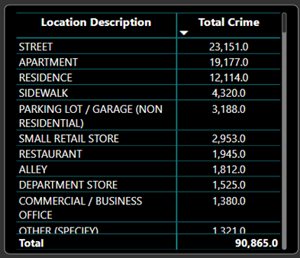
8. Is there any “Location Description” where the number of crimes is higher than expected? Come up with a table or visualization in which one can judge the frequency of crimes at each Location Description type.
Ans 8. Locations like Street, Apartment and Residence have very high crimes

Slide 27
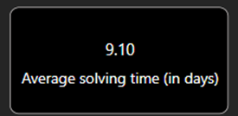


9. What is the average time between reporting and solving a case as per the data?
Ans 9. I created a measure for that
Below is the DAX formula for solving time (in days)

Slide 28
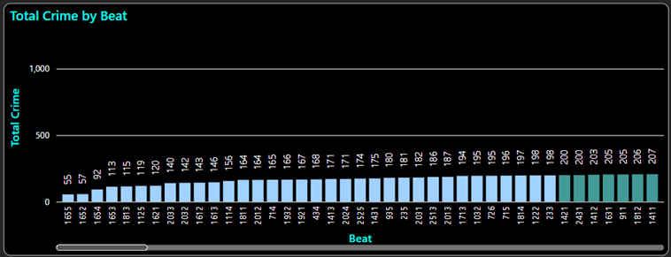
10. To reward the patrol officers, find the patrol area where the crimes reported were under control.
Ans 10. In data, patrol areas were provided as beat (code), I categorised beats were crime was under 200 as under control.

Slide 29
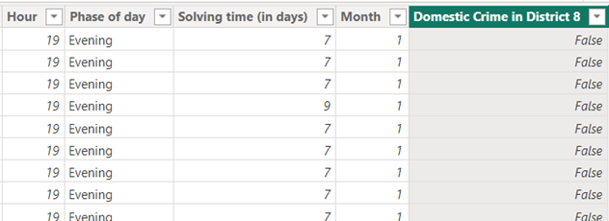

11. Did you create any calculated columns in this project? What is the difference between the ‘calculated column’ and ‘add column’ functions?
Ans 11. Yes I created some calculated columns which were :
I extracted hours from date column for “Hour” calculated column
Dax formula for Phase of day:

Slide 30



Dax formula for Solving time (in days) :
Dax formula for Month:
Dax formula for Domestic Crimes in District 8:
Calculated columns are static and built using DAX formulae within the data model, whereas "Add Column" functions are dynamic and used throughout the data transformation process in Power Query Editor.

Slide 31
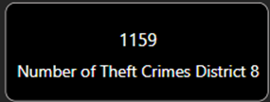
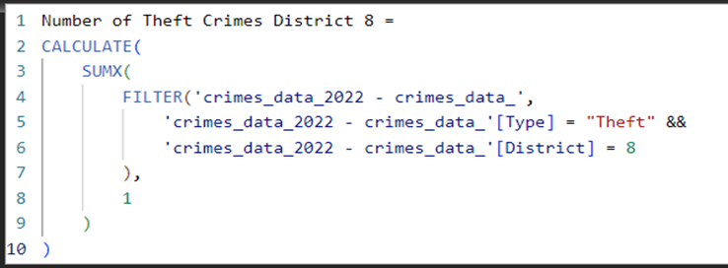
12. Using ‘Calculate’ and a row iteration DAX function calculate the number of crimes which are of type ‘theft’ and happened in ‘District 8’.
Ans 12.
13. Using PowerBI can you separate the Longitude and Latitude from the Locations Column (Longitude, Latitude)? Which feature will you use?
Ans 13. Yes, Using PowerBI we can separate the Longitude and Latitude from the Locations Column (Longitude, Latitude), I used split column feature in home tab of power query editor and used “,” as the delimiter.

Slide 32
14. When we add a column in Power Query what’s the code that comes in M language in formula bar? What do you know about M-query?
Ans 14. The M language, commonly known as the "Power Query Formula Language". It is a functional language used for data transformation activities in the Power Query Editor of programs including as Power BI.
Formula for adding a new column in M-query is:
= Table.AddColumn(#"PreviousStepName", "NewColumnName", each [Column1] + [Column2])
Table.AddColumn: This function adds a new column to the data table.
#"PreviousStepName": This refers to the step in the data transformation process before adding the new column.
"NewColumnName": This is the name of the new column being added.
each [Column1] + [Column2]: This is the expression that calculates the values for each row in the new column. Here, it adds the values from two existing columns, 'Column1' and 'Column2'.

Slide 33
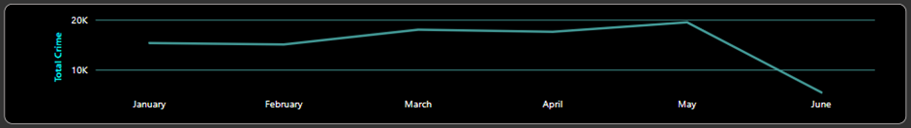
Subjective Q&A
1. Is there any month-wise change in crime rates? If not, what could be the mistake in that operation?
Ans 1. Yes, there is month-change in crime rates:
The crime rates went drastically down in month of June which suggest string measures were taken for reducing the crime

Slide 34
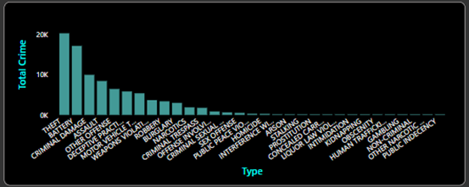
2. How can we reduce the no. of crimes, and which types of crime should we focus on to achieve improvement in the overall number of crimes?
Ans 2.
We should focus on crime types like Theft, Battery and Criminal Damage to achieve improvement in the overall number of crimes.
We can reduce no. crimes by better equipping our police forces for handling more frequently accruing type of crimes and by making more arrests.

Slide 35
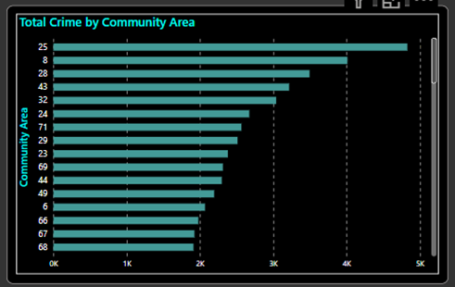
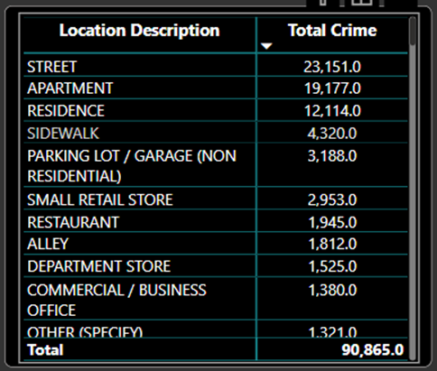
3. Which localities experience higher crime rates, and what measures can we ensure to reduce these numbers?
Ans 3. In this question I’m considering community areas as localities because there is no column as localities in the given data:
We can see that there high number of crimes occurring on streets, apartments and residences so we can spread awareness and train our police forces better to handle crimes in these locations:

Slide 36
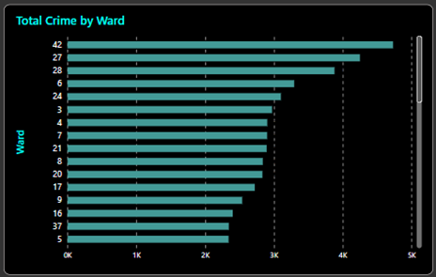
4. Can you suggest wards where security improvements should be made to reduce crime?
Ans 4. In this visualization we can see the ward no. 42, 27, 28, 6 and 24 crimes over 3000 and need immediate security improvements.

Slide 37
5. Crime Rate Trend Analysis: Monitor changes in crime rates over time to detect any discernible patterns or trends.
Ans 5. We can see that number of crime drastically decreased in the month of june.

Slide 38
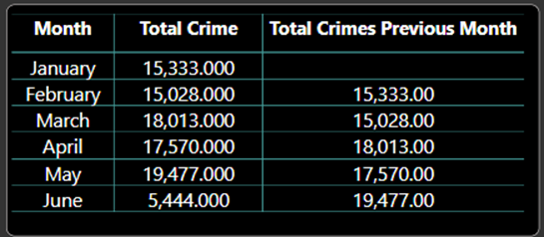
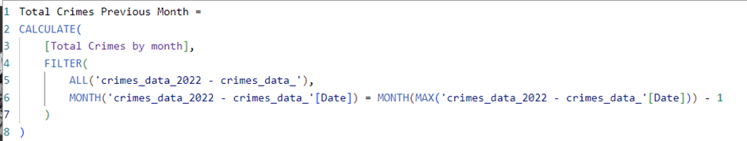
6. Create a monthwise tabular data consisting of two columns, month and total no. of crimes in that month. Also, add one more column where each row of the column contains the total no. of crimes for the previous month. Do we need to use any filter-based DAX function here (All, All except, etc)?
Ans 6.
I created a new measure “Total Crimes Previous Month” and I used filter based DAX function “ALL” and “ALLEXCEPT”

Slide 39

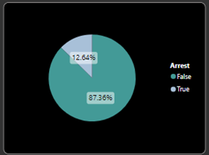
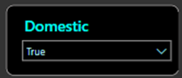
Dax function for “Total Crimes by month”:
7. As per the previous reports, most domestic crimes do not result in arrest due to public hesitation and family pressure, is this trend also visible in our data?
Ans 7. Yes, trend is also visible in our data as only 12.64% of reported domestic crimes resulted in arrests.

Slide 40
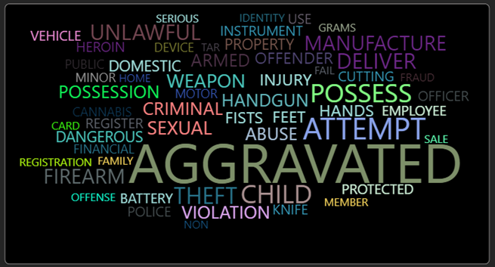
8. Could you generate a visual representation that emphasizes the frequently occurring terms within the "Description" column?
Ans 8. Yes, I used word cloud visual to represent the most frequently occurring terms within the "Description" column:
Here we can see terms like Aggravated, attempt, possess, theft and chid are most frequently occurring.

Slide 41
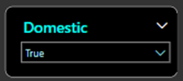
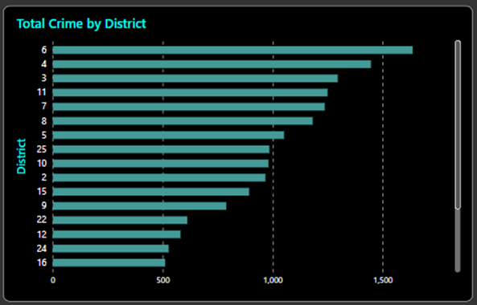
9. Are there any particular regions as per the data where the number of domestic crimes reported is very high?
Ans 9. In this case I’m considering total crime distribution over districts:
I selected domestic crime slicer as True for all the domestic crimes
I assumed crimes over 1000 as very high so according to that districts 6, 4, 3, 11, 7, 8 and 5 have high number of domestic crimes.

Slide 42
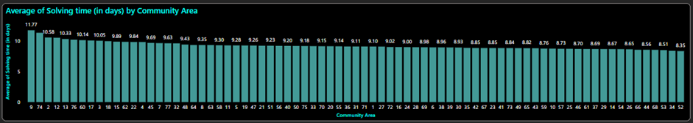
10. Is the solving time of cases also dependent upon the type and locality of crime?
Ans 10. In this question I’m considering Community areas as there no column mentioned as localities in the data given
Solving time across community areas ranges from 11.77 days to 8.35 days which in my opinion in not much.

Slide 43
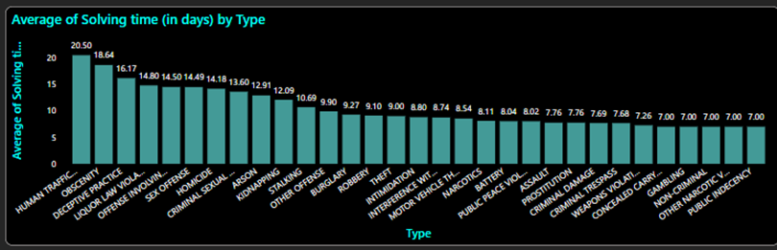
On the other hand solving time across different types of crimes ranges from 20.5 days to 7.00 days which is a considerable difference with Human Trafficking crimes taking the most time to solve and Public Indecency taking least amount of time to solve.

Slide 44
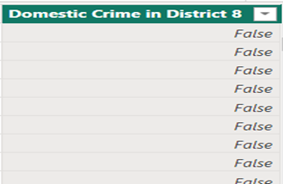
11. Create a calculated column to flag the domestic crimes that took place in District 8.
Ans 11.
Dax formula for Domestic Crimes in District 8:

Slide 45
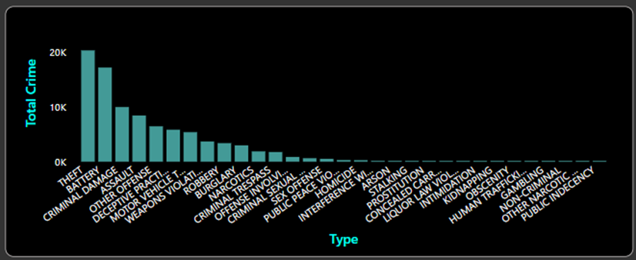
12. Out of all the types of crimes which do you think is the most dangerous one and rank the type of crimes according to their no. of occurrences?
Ans 12. According to occurrences this is the distribution of types of crimes:
According to this distribution Theft, Battery and Criminal Damage are the most dangerous crimes.

Slide 46
13. What do you understand by PowerBI gateway? What are its use cases?
Ans 13. The Power BI Gateway is a bridge that allows for safe connection between on-premises data sources and the cloud-based Power BI service. It serves as a bridge between a organization's network and the cloud-based Power BI service.
As its use cases Power BI Gateway facilitates scheduled data refreshes, real-time data access, hybrid data integration, secure communication, centralized management, and self-service analytics across cloud and on-premises environments.

Slide 47
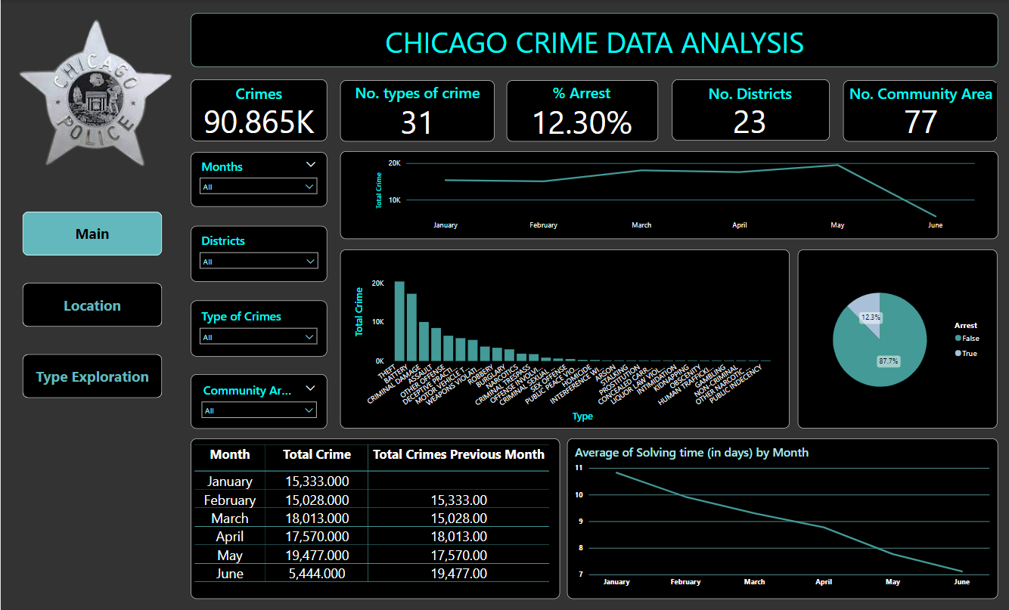
Dashboard Snippet

Slide 48
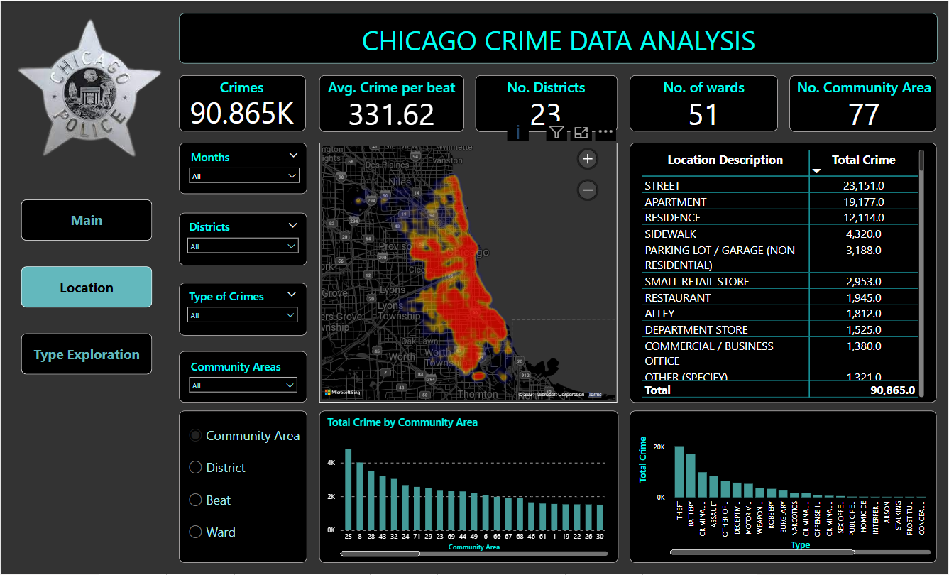
Dashboard Snippet

Slide 49
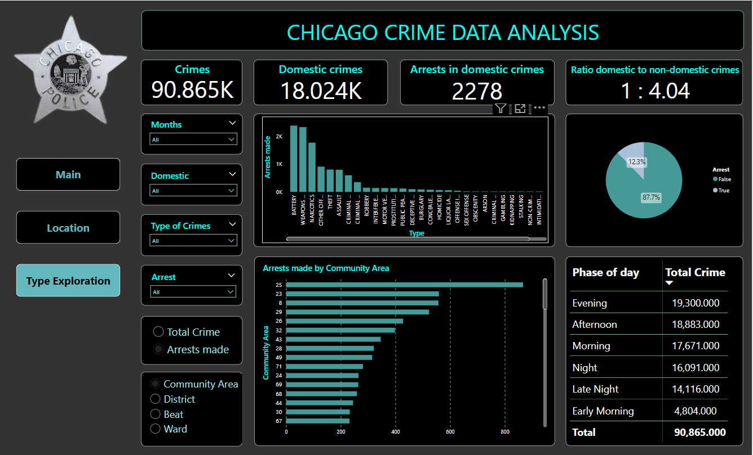
Dashboard Snippet

Slide 50
Conclusion:
The analysis on dataset shows crime rate in different districts, community areas and wards. We can say that in past months crimes rate was decreased and average solving time also decreased, but further improvements are still needed to keep the crime rate in control in some districts, community areas and wards.
We identified the most frequently occurring type of crimes based on their number of occurrence. We found that Theft, Battery and Criminal Damages are most dangerous crimes based on occurrence.
In this analysis we also analysed the domestic crimes happening across Chicago, it was found that around 20% of the total crimes were domestic, which is alarming.
We concluded that more arrest should me made to reduce crimes further as arrest rate was only 12.3% and for domestic crimes it is 12.64%.

Slide 51



